Slide 1

Fundamentals of Data Science 21CSS202T

Slide 2
Unit III
Django Web Framework: Web development basics and Features of Django, Installing Django and MVC model , HTTP webserver concepts - Use HTTP request and response objects, Create Views, Use URLConf - URL Mapping
Introduction to Django Template System, Load Template Files, Render Templates, Create Forms, Process Form Data and Customize Form Field Validation
Introduction to Django Models, Use Model Fields, populate a Database, CRUD, Use QuerySets for data retrieval, Use jQuery and AJAX with Django to create Dynamic websites
T7: Implement Django framework using python – creating basic Django App
T8: Create a simple View using Django
T9: Implement Django app for real-time applications using MVC model

Slide 3
Django
Django is a back-end server side web framework.
Django is free, open source and written in Python.
Django makes it easier to build web pages using Python.

Slide 4
Django
Django is a Python-based web framework which allows you to quickly create web application without all of the installation or dependency problems that you normally will find with other frameworks.
When you’re building a website, you always need a similar set of components:
a way to handle user authentication (signing up, signing in, signing out)
a management panel for your website,
Forms
a way to upload files, etc.
Django gives you ready-made components to use.

Slide 5
Why Django?
It’s very easy to switch database in Django framework.
It has built-in admin interface which makes easy to work with it.
Django is fully functional framework that requires nothing else.
It has thousands of additional packages available.
It is very scalable.

Slide 6
Features of Django
Versatility of Django Django can build almost any type of website. It can also work with any client-side framework and can deliver content in any format such as HTML, JSON, XML etc. Some sites which can be built using Django are wikis, social networks, new sites etc.
Security Since Django framework is made for making web development easy, it has been engineered in such a way that it automatically do the right things to protect the website. For example, In the Django framework instead of putting a password in cookies, the hashed password is stored in it so that it can’t be fetched easily by hackers.

Slide 7
Features of Django
Scalability Django web nodes have no stored state, they scale horizontally – just fire up more of them when you need them. Being able to do this is the essence of good scalability. Instagram and Disqus are two Django based products that have millions of active users, this is taken as an example of the scalability of Django.
Portability All the codes of the Django framework are written in Python, which runs on many platforms. Which leads to run Django too in many platforms such as Linux, Windows and Mac OS.

Slide 8
Popularity of Django
Disqus, Instagram, Knight Foundation, MacArthur Foundation, Mozilla, National Geographic etc. There are more than 5k online sites based on Django framework.
Sites like Hot Frameworks assess the popularity of a framework by counting the number of GitHub projects and StackOverflow questions for each platform, here Django is in 6th position.

Slide 9
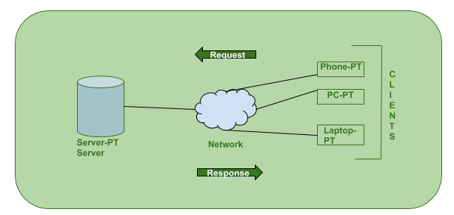
Web Development Basics

Slide 10
Web Development Basics
The Client-server model is a distributed application structure that partitions task or workload between the providers of a resource or service, called servers, and service requesters called clients.
In the client-server architecture, when the client computer sends a request for data to the server through the internet, the server accepts the requested process and deliver the data packets requested back to the client.
Clients do not share any of their resources.
Examples of Client-Server Model are Email, World Wide Web, etc.

Slide 11
Web Development Basics
How the Client-Server Model works ? Client: When we talk the word Client, it mean to talk of a person or an organization using a particular service. Similarly in the digital world a Client is a computer (Host) i.e. capable of receiving information or using a particular service from the service providers (Servers).
Servers: Similarly, when we talk the word Servers, It mean a person or medium that serves something. Similarly in this digital world a Server is a remote computer which provides information (data) or access to particular services.

Slide 12
Django Installation
Install pip- Open command prompt and enter following command
python -m pip install -U pip
Install virtual environment- Enter following command in cmd-
pip install virtualenv
Set Virtual environment- Setting up the virtual environment will allow you to edit the dependency which generally your system wouldn’t allow.

Slide 13
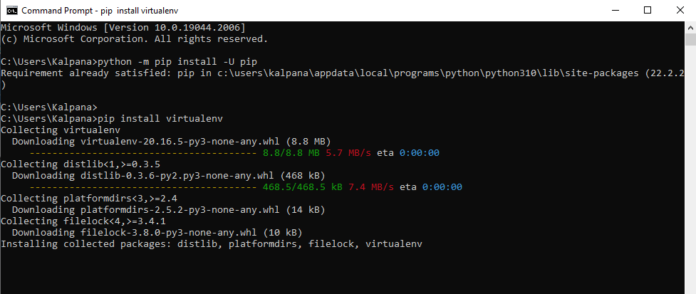
Django Installation

Slide 14
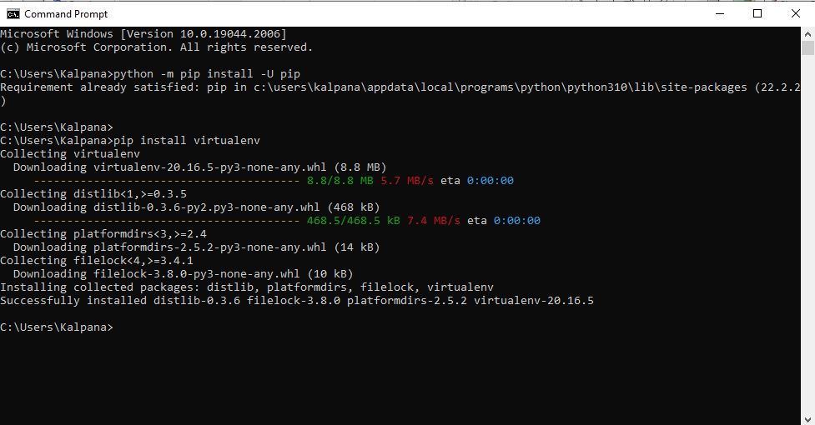
Django Installation

Slide 15
Django Installation
Follow these steps to set up a virtual environment
Create a virtual environment by giving this command in
virtualenv env_site
2) Change directory to env_site by this command
cd env_site
3) Go to Scripts directory inside env_site and activate virtual environment
cd Scripts
activate

Slide 16
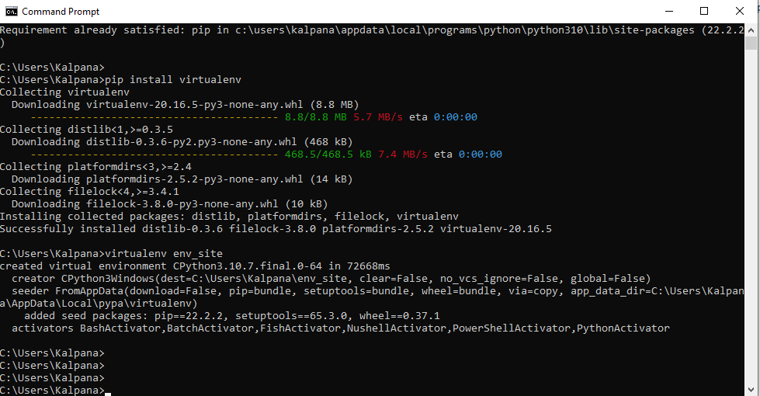
Django Installation

Slide 17
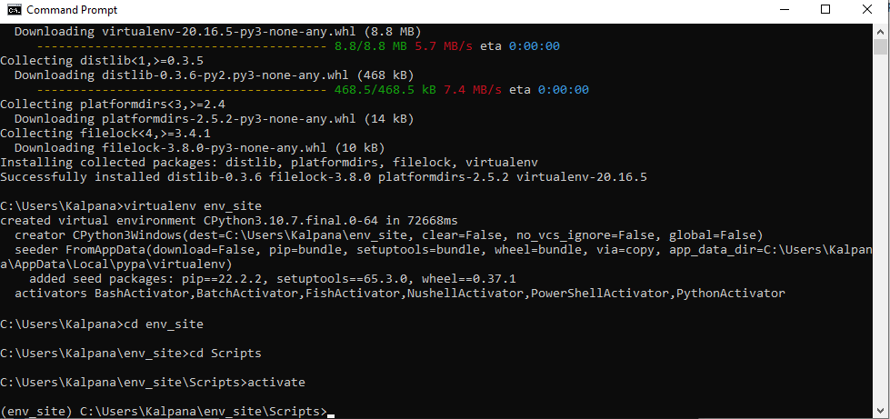
Django Installation

Slide 18
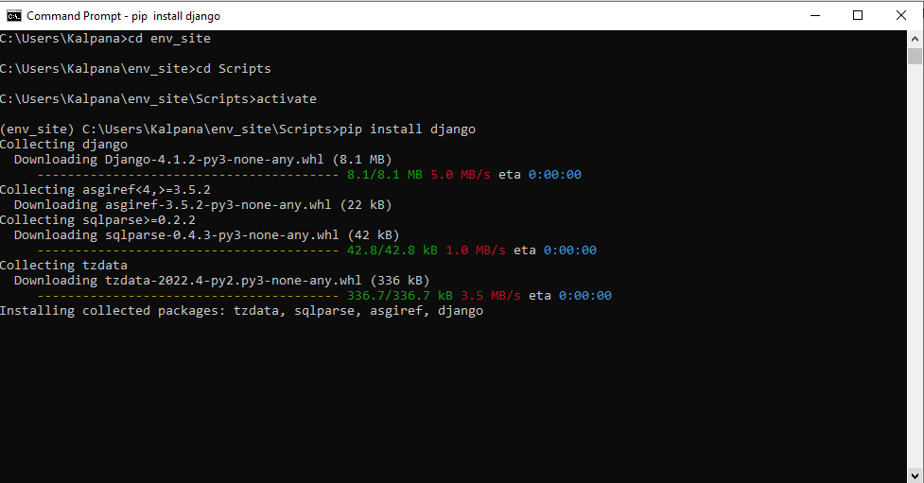
Django Installation

Slide 19
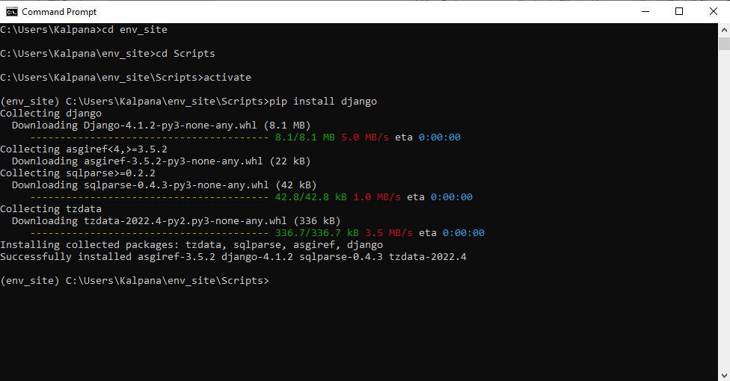
Django Installation

Slide 20
Django Installation
Install Django- Install django by giving following command
pip install django
Return to the env_site directory
cd ..
Start a project by following command
django-admin startproject fds-demo
Change directory to fds-demo
cd fds-demo
Start the server- Start the server by typing following command in cmd
python manage.py runserver

Slide 21
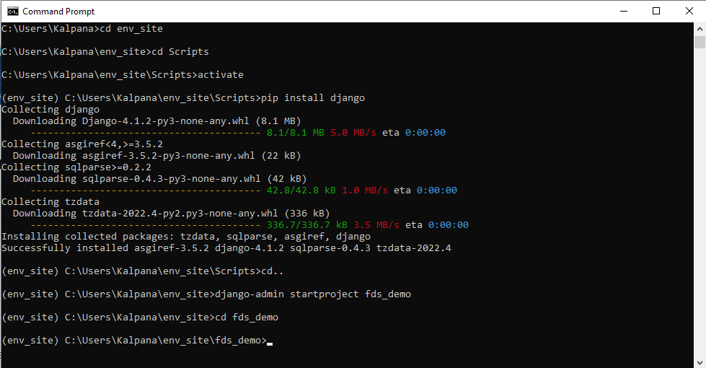
Django Installation

Slide 22
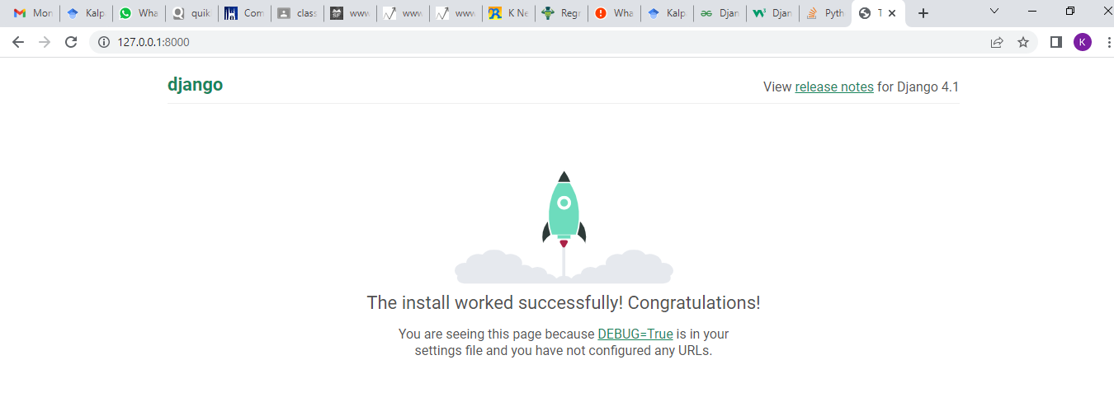
Django Installation
To check whether server is running or not go to web browser and enter http://127.0.0.1:8000/ as url.

Slide 23
MVC Model
Django is based on MVT (Model-View-Template) architecture.
MVT is a software design pattern for developing a web application.
MVT has three parts:
Model
View
Template

Slide 24
MVC Model
The Model helps to handle database. It is a data access layer which handles the data.
The Template is a presentation layer which handles User Interface part completely. The View is used to execute the business logic and interact with a model to carry data and renders a template.
Although Django follows MVC pattern but maintains it’s own conventions. So, control is handled by the framework itself.
There is no separate controller and complete application is based on Model View and Template. That’s why it is called MVT application.

Slide 25
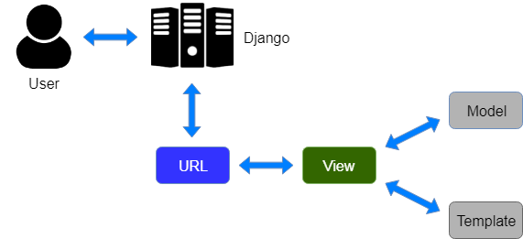
MVC Model

Slide 26
MVC Model
Here, a user requests for a resource to the Django, Django works as a controller and check to the available resource in URL.
If URL maps, a view is called that interact with model and template, it renders a template.
Django responds back to the user and sends a template as a response.

Slide 27
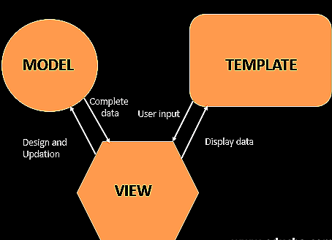
MVC Model

Slide 28
MVC Model
Model: The model is going to act as the interface of your data. It is responsible for maintaining data. It is the logical data structure behind the entire application and is represented by a database (generally relational databases such as MySql, Postgres).
View: The View is the user interface — what you see in your browser when you render a website. It is represented by HTML/CSS/Javascript and Jinja files.
Template: A template consists of static parts of the desired HTML output as well as some special syntax describing how dynamic content will be inserted.

Slide 29
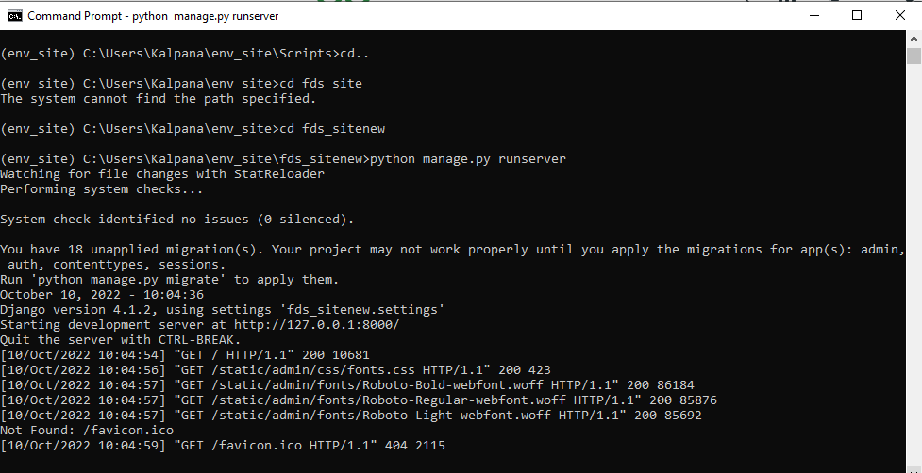
Project Structure
Ctrl + C – exit from server

Slide 30
Project Structure
A Django Project when initialized contains basic files by default such as manage.py, view.py, etc.
A simple project structure is enough to create a single-page application.
Here are the major files and their explanations. Inside the fds_sitenew folder ( project folder ) there will be the following files-
manage.py
fds_sitenew (Folder)

Slide 31
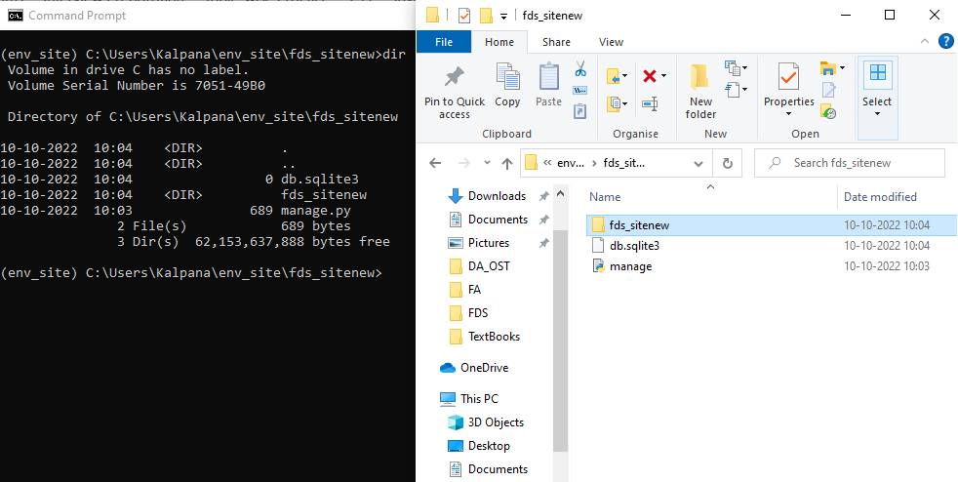
Project Structure

Slide 32
Project Structure
manage.py- This file is used to interact with your project via the command line(start the server, sync the database… etc). For getting the full list of commands that can be executed by manage.py type this code in the command window-
$ python manage.py help
folder ( fds_sitenew ) – This folder contains all the packages of your project. Initially, it contains four files –
_init_.py
settings.py
url.py
wsgi.py

Slide 33
Project Structure
_init_.py – It is a python package. It is invoked when the package or a module in the package is imported. We usually use this to execute package initialization code, for example for the initialization of package-level data.
settings.py – As the name indicates it contains all the website settings. In this file, we register any applications we create, the location of our static files, database configuration details, etc.
urls.py – In this file, we store all links of the project and functions to call.
wsgi.py – This file is used in deploying the project in WSGI. It is used to help your Django application communicate with the webserver.

Slide 34
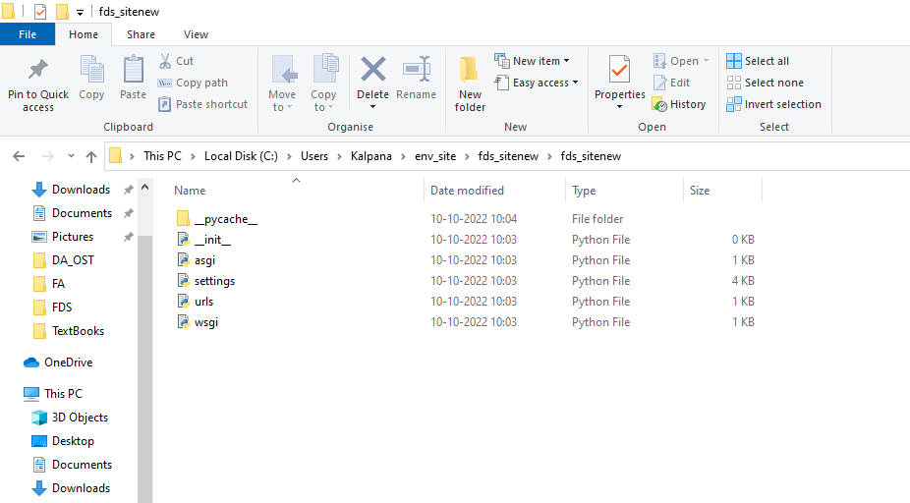
Project Structure

Slide 35
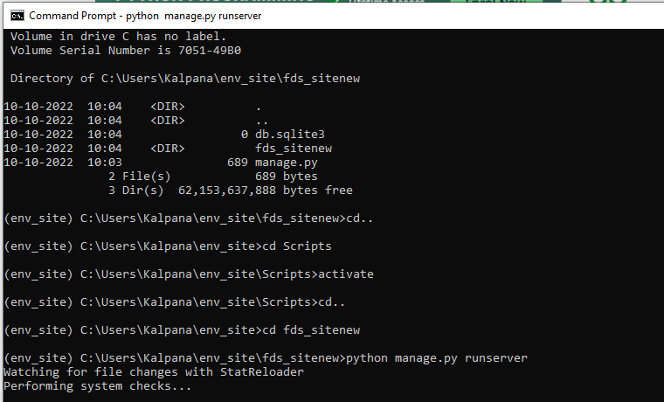
Project Structure

Slide 36
Project Structure
Create a new file views.py inside the project folder where settings.py, #urls.py and other files are stored and save the following code
# HttpResponse is used to
# pass the information
# back to view
from django.http import HttpResponse
# Defining a function which
# will receive request and
# perform task depending
# upon function definition
def hello_srm (request) :
# This will return Hello Geeks
# string as HttpResponse
return HttpResponse("Hello SRM")

Slide 37
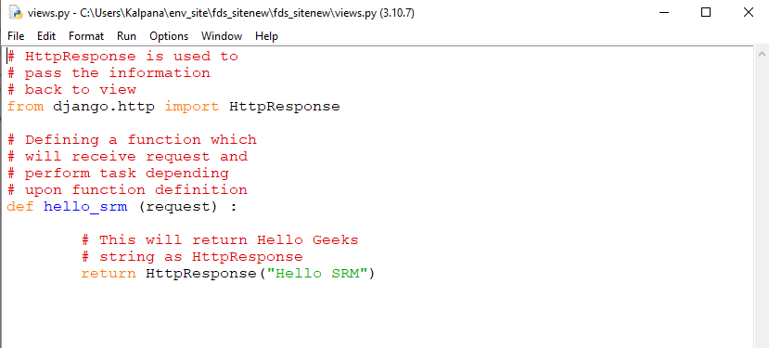
Project Structure
Create a new file views.py inside the project folder where settings.py, #urls.py and other files are stored and save the following code

Slide 38
Project Structure
Open urls.py inside project folder (projectName) and add your entry-
Import hello_srm function from views.py file.
from projectName.views import hello_srm

Slide 39
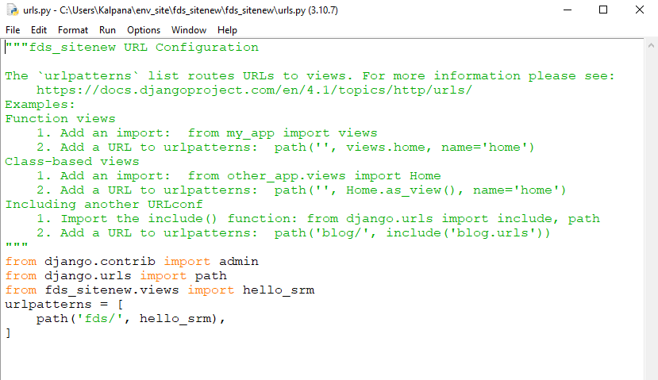
Project Structure

Slide 40
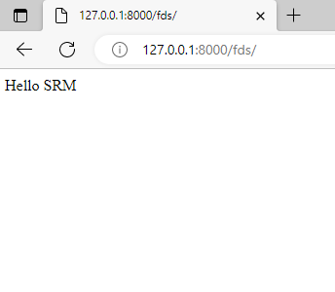
Project Structure

Slide 41
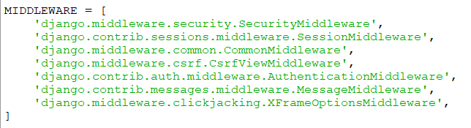
Middleware
Middleware is like a middle ground between a request and response.
It is like a window through which data passes. As in a window, light passes in and out of the house. Similarly, when a request is made it moves through middlewares to views, and data is passed through middleware as a response.

Slide 42
HttpRequest and HttpResponse
The client-server architecture includes two major components request and response.
The Django framework uses client-server architecture to implement web applications.
When a client requests for a resource, a HttpRequest object is created and correspond view function is called that returns HttpResponse object.
To handle request and response, Django provides HttpRequest and HttpResponse classes.
Each class has it’s own attributes and methods.

Slide 43
HttpRequest and HttpResponse
Django uses request and response objects to pass state through the system. When a page is requested, Django creates an HttpRequest object that contains metadata about the request. Then Django loads the appropriate view, passing the HttpRequest as the first argument to the view function. Each view is responsible for returning an HttpResponse object.
Django HttpRequest
This class is defined in the django.http module and used to handle the client request.

Slide 44
HttpRequest and HttpResponse
Attribute | Description
HttpRequest.scheme | A string representing the scheme of the request (HTTP or HTTPs usually).
HttpRequest.body | It returns the raw HTTP request body as a byte string.
HttpRequest.path | It returns the full path to the requested page does not include the scheme or domain.
HttpRequest.path_info | It shows path info portion of the path.
HttpRequest.method | It shows the HTTP method used in the request.
HttpRequest.encoding | It shows the current encoding used to decode form submission data.
HttpRequest.content_type | It shows the MIME type of the request, parsed from the CONTENT_TYPE header.

Slide 45
HttpRequest and HttpResponse
Attribute | Description
HttpRequest.content_params | It returns a dictionary of key/value parameters included in the CONTENT_TYPE header.
HttpRequest.GET | It returns a dictionary-like object containing all given HTTP GET parameters.
HttpRequest.POST | It is a dictionary-like object containing all given HTTP POST parameters.
HttpRequest.COOKIES | It returns all cookies available.
HttpRequest.FILES | It contains all uploaded files.
HttpRequest.META | It shows all available Http headers.
HttpRequest.resolver_match | It contains an instance of ResolverMatch representing the resolved URL.

Slide 46
HttpRequest - Methods
Attribute | Description
HttpRequest.get_host() | It returns the original host of the request.
HttpRequest.get_port() | It returns the originating port of the request.
HttpRequest.get_full_path() | It returns the path, plus an appended query string, if applicable.
HttpRequest.build_absolute_uri (location) | It returns the absolute URI form of location.
HttpRequest.get_signed_cookie (key, default=RAISE_ERROR, salt='', max_age=None) | It returns a cookie value for a signed cookie, or raises a django.core.signing.BadSignature exception if the signature is no longer valid.
HttpRequest.is_secure() | It returns True if the request is secure; that is, if it was made with HTTPS.
HttpRequest.is_ajax() | It returns True if the request was made via an XMLHttpRequest.

Slide 47
HttpRequest
Django HttpRequest Example
views.py
def methodinfo(request):
return HttpResponse("Http request is: "+request.method)
urls.py
path('info',views.methodinfo)

Slide 48
HttpRequest
Django HttpRequest Example
views.py
def methodinfo(request):
return HttpResponse("Http request is: "+request.method)
urls.py
from newdemo.views import methodinfo
path('info', methodinfo)

Slide 49
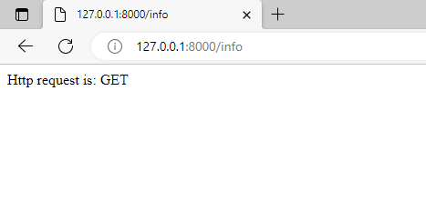
HttpRequest
Django HttpRequest Example

Slide 50
HttpResponse
Django uses request and response objects to pass state through the system. When a page is requested, Django creates an HttpRequest object that contains metadata about the request. Then Django loads the appropriate view, passing the HttpRequest as the first argument to the view function. Each view is responsible for returning an HttpResponse object.
This class is a part of django.http module.
It is responsible for generating response corresponds to the request and back to the client.

Slide 51
HttpResponse
Attribute | Description
HttpResponse.content | A bytestring representing the content, encoded from a string if necessary.
HttpResponse.charset | It is a string denoting the charset in which the response will be encoded.
HttpResponse.status_code | It is an HTTP status code for the response.
HttpResponse.reason_phrase | The HTTP reason phrase for the response.
HttpResponse.streaming | It is false by default.
HttpResponse.closed | It is True if the response has been closed.

Slide 52
HttpResponse
Method | Description
HttpResponse.__init__(content='', content_type=None, status=200, reason=None, charset=None) | It is used to instantiate an HttpResponse object with the given page content and content type.
HttpResponse.__setitem__(header, value) | It is used to set the given header name to the given value.
HttpResponse.__delitem__(header) | It deletes the header with the given name.
HttpResponse.__getitem__(header) | It returns the value for the given header name.
HttpResponse.has_header(header) | It returns either True or False based on a case-insensitive check for a header with the provided name.
HttpResponse.setdefault(header, value) | It is used to set default header.

Slide 53
HttpResponse
Method | Description
HttpResponse.write(content) | It is used to create response object of file-like object.
HttpResponse.flush() | It is used to flush the response object.
HttpResponse.tell() | This method makes an HttpResponse instance a file-like object.
HttpResponse.getvalue() | It is used to get the value of HttpResponse.content.
HttpResponse.readable() | This method is used to create stream-like object of HttpResponse class.
HttpResponse.seekable() | It is used to make response object seekable.

Slide 54
Create Views
Django Views are one of the vital participants of MVT Structure of Django.
As per Django Documentation, A view function is a Python function that takes a Web request and returns a Web response.
This response can be the HTML contents of a Web page, or a redirect, or a 404 error, or an XML document, or an image, anything that a web browser can display.

Slide 55
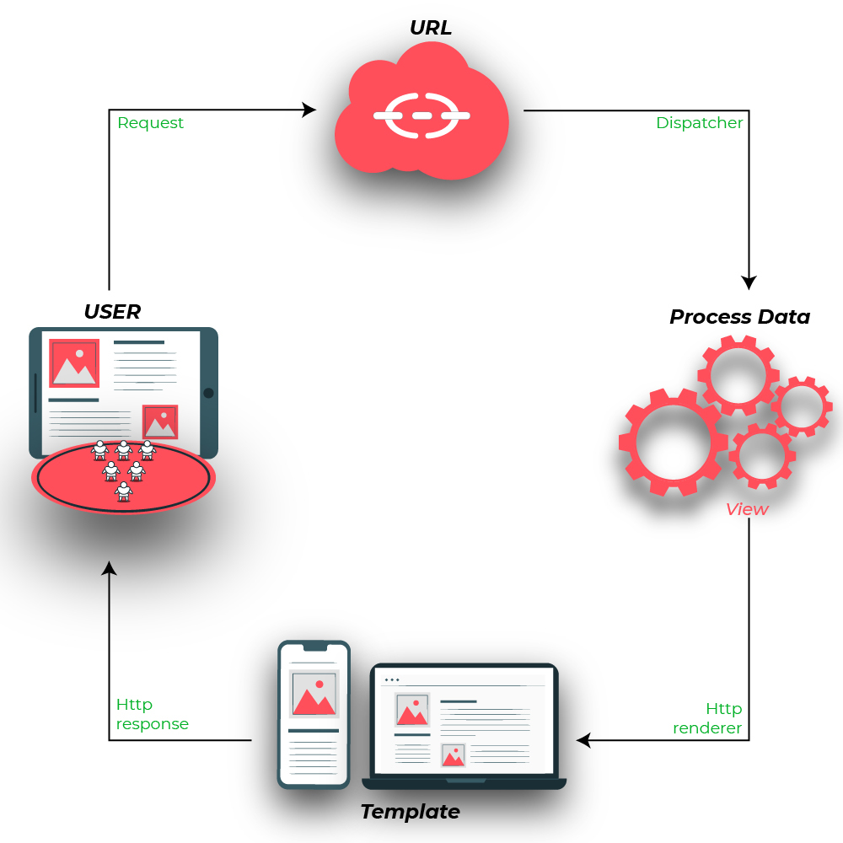
Create Views
Django views are part of the user interface — they usually render the HTML/CSS/Javascript in your Template files into what you see in your browser when you render a web page.

Slide 56
Create Views
# import Http Response from django
from django.http import HttpResponse
# get datetime
import datetime
# create a function
def demo_view(request):
# fetch date and time
now = datetime.datetime.now()
# convert to string
html = "Time is {}".format(now)
# return response
return HttpResponse(html)

Slide 57
Create Views
from django.urls import path
# importing views from views..py
from .views import demo_view
urlpatterns = [
path('', demo_view),
]

Slide 58
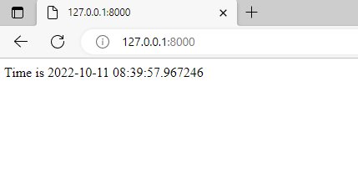
Create Views

Slide 59
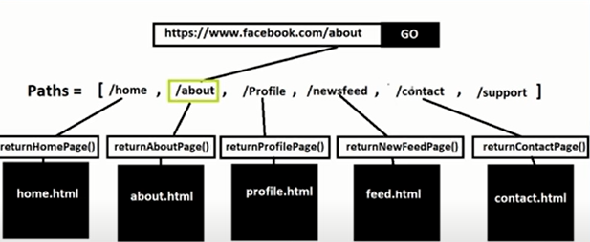
Use URLConf

Slide 60
Use URLConf
from django.contrib import admin
from django.urls import path
from django.http import HttpResponse
def home(request):
return HttpResponse("Home page")
def contact(request):
return HttpResponse("Contact page")
urlpatterns = [
path('admin/', admin.site.urls),
path('', home),
path('about/', contact),
]

Slide 61
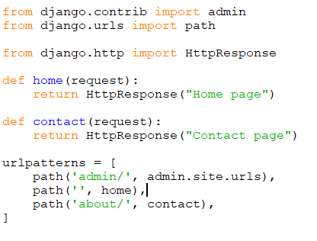
Use URLConf

Slide 62
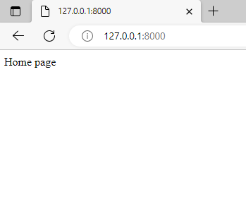
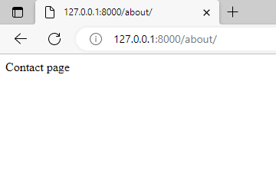
Use URLConf

Slide 63
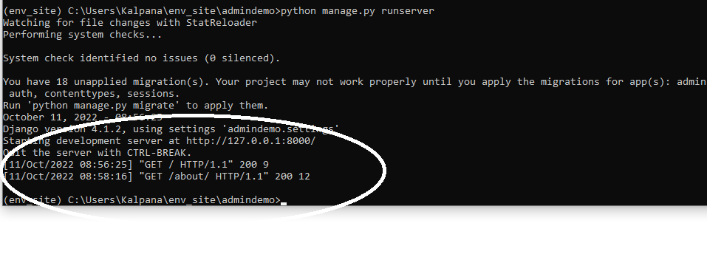
Use URLConf

Slide 64
URL Mapping
Django is a web application framework, it gets user requests by URL locater and responds back.
To handle URL, django.urls module is used by the framework.
urls.py
from django.contrib import admin
from django.urls import path
urlpatterns = [
path('admin/', admin.site.urls),
]

Slide 65
URL Mapping
Django already has mentioned a URL here for the admin. The path function takes the first argument as a route of string or regex type.
The view argument is a view function which is used to return a response (template) to the user.
The django.urls module contains various functions, path(route,view,kwargs,name) is one of those which is used to map the URL and call the specified view.

Slide 66
URL Mapping
from django.shortcuts import render
# Create your views here.
from django.http import HttpResponse, HttpResponseNotFound
from django.views.decorators.http import require_http_methods
@require_http_methods(["GET"])
def hello(request):
return HttpResponse('<h1>This is Http GET request.</h1>')

Slide 67
URL Mapping
from django.contrib import admin
from django.urls import path
from myapp import views
urlpatterns = [
path('admin/', admin.site.urls),
path('index/', views.index),
path('hello/', views.hello),
]
Now, start the server and enter 127.0.0.1:8000/hello to the browser. This URL will be mapped into the list of URLs and then call the corresponding function from the views file.
In this example, hello will be mapped and call hello function from the views file. It is called URL mapping.

Slide 68
Create an App
A project is a sum of many applications.
Every application has an objective and can be reused into another project, like the contact form on a website can be an application, and can be reused for others.
See it as a module of your project.
Create an Application
We assume you are in your project folder. In our main “myproject” folder, the same folder then manage.py −
$ python manage.py startapp myapp

Slide 69
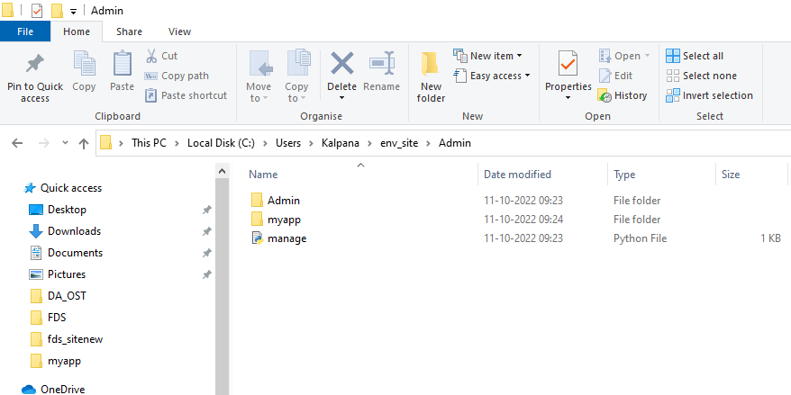
Create an App

Slide 70
Create an App
You just created myapp application and like project, Django create a “myapp” folder with the application structure −
myapp/
__init__.py
admin.py
models.py
tests.py
views.py

Slide 71
Create an App
__init__.py − Just to make sure python handles this folder as a package.
admin.py − This file helps you make the app modifiable in the admin interface.
models.py − This is where all the application models are stored.
tests.py − This is where your unit tests are.
views.py − This is where your application views are.

Slide 72
Create an App
Get the Project to Know About Your Application
At this stage we have our "myapp" application, now we need to register it with our Django project "myproject". To do so, update INSTALLED_APPS tuple in the settings.py file of your project (add your app name) −
INSTALLED_APPS = (
'django.contrib.admin',
'django.contrib.auth',
'django.contrib.contenttypes',
'django.contrib.sessions',
'django.contrib.messages',
'django.contrib.staticfiles',
'myapp',
)

Slide 73
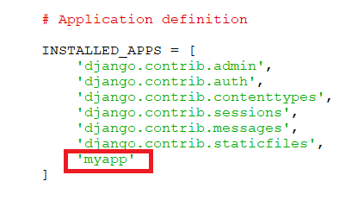
Create an App

Slide 74
Create an App
Before launching your server, to access your Admin Interface, you need to initiate the database −
$ python manage.py migrate
syncdb will create necessary tables or collections depending on your db type, necessary for the admin interface to run. Even if you don't have a superuser, you will be prompted to create one.
If you already have a superuser or have forgotten it, you can always create one using the following code −
$ python manage.py createsuperuser

Slide 75
Create an App
Now just run the server.
$ python manage.py runserver
And your admin interface is accessible at: http://127.0.0.1:8000/admin/

Slide 76
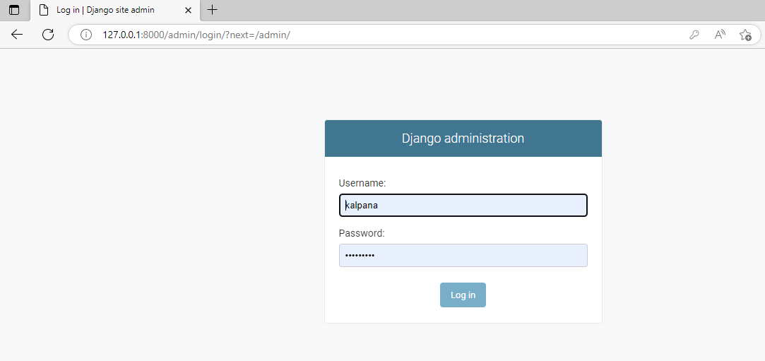
Create an App

Slide 77
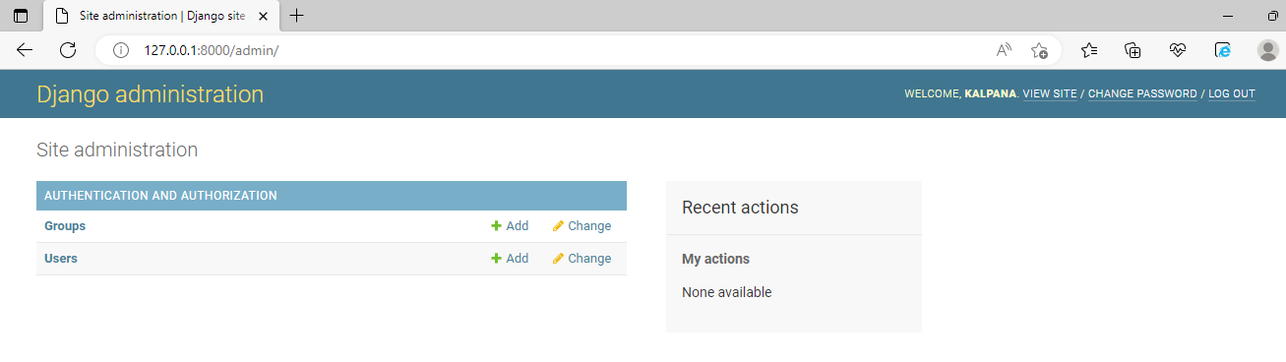
Create an App

Slide 78
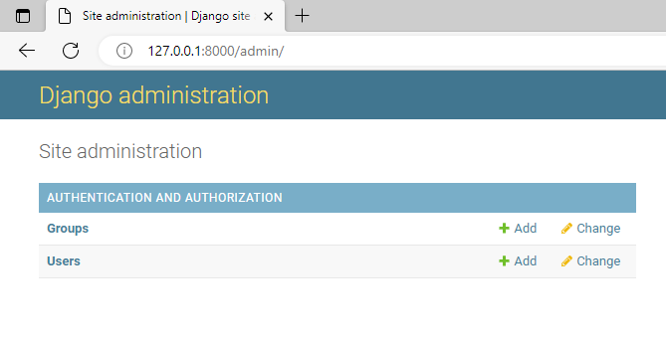
Create an App

Slide 79
Introduction to Django Template System, Load Template Files, Render Templates, Create Forms, Process Form Data and Customize Form Field Validation

Slide 80
Templates
Django provides a convenient way to generate dynamic HTML pages by using its template system.
A template consists of static parts of the desired HTML output as well as some special syntax describing how dynamic content will be inserted.

Slide 81
Why Templates?
We are hardcoding HTML code inside our views. At a later date, if we want to modify our HTML it would be very painful to go through each view one by one to modify the page.
Django comes bundled with a powerful templating system which allows us to create complex HTML pages easily instead of hardcoding them inside views. If we keep hardcoding HTML directly in the view we wouldn't be able to use loops or conditional statements that Django templating system provides inside our HTML
In the real world, a page consists of many dynamic components. Embedding dynamic content in a large page using format() method is very error-prone and tedious.
At this point, we haven't yet introduced database into the scene because it would create more mess.

Slide 82
Why Templates?
In HTML file, we can't write python code because the code is only interpreted by python interpreter not the browser. We know that HTML is a static markup language, while Python is a dynamic programming language.
Django template engine is used to separate the design from the python code and allows us to build dynamic web pages.
Templates not only show static data but also the data from different databases connected to the application through a context dictionary

Slide 83
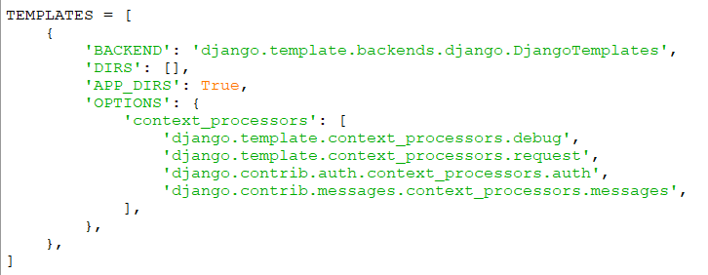
Templates

Slide 84
Simple Template
<!DOCTYPE html>
<html> <head> <title>Blog Post</title> </head>
<body>
<h1>{{ post_title }}</h1>
<p>Published by <span>Author : {{ author|title }}</span></p>
<p>{{ post_content }}</p>
<p>Related Posts:</p>
<ul>
{% for item in item_list %}
<li>{{ item }}</li>
{% endfor %}
</ul>
{% if comments %}
<p>This post has some comments</p>
{% else %}
<p>This post has no comments</p>
{% endif %}
</body></html>

Slide 85
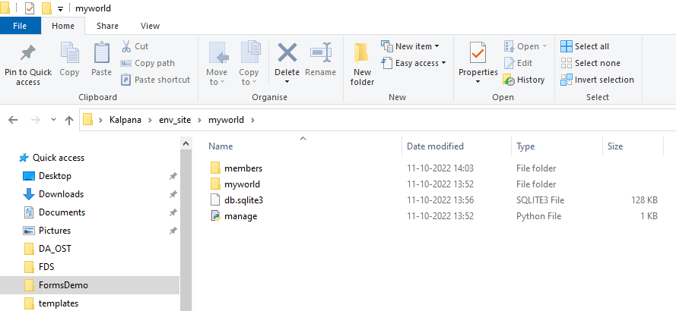
Templates
Create a templates folder inside the members folder, and create a HTML file named myfirst.html.

Slide 86
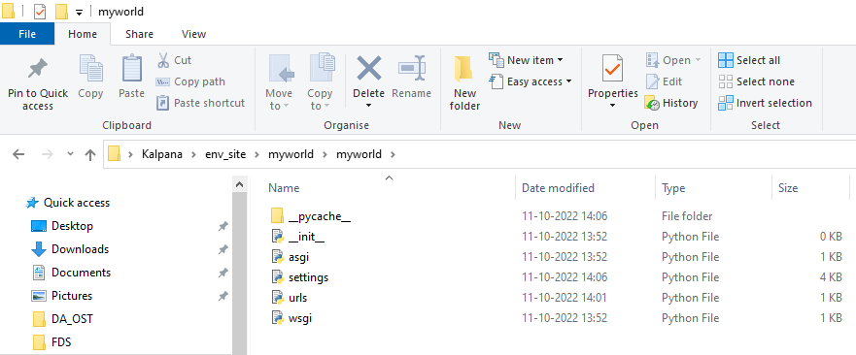
Templates
Create a templates folder inside the members folder, and create a HTML file named myfirst.html.

Slide 87
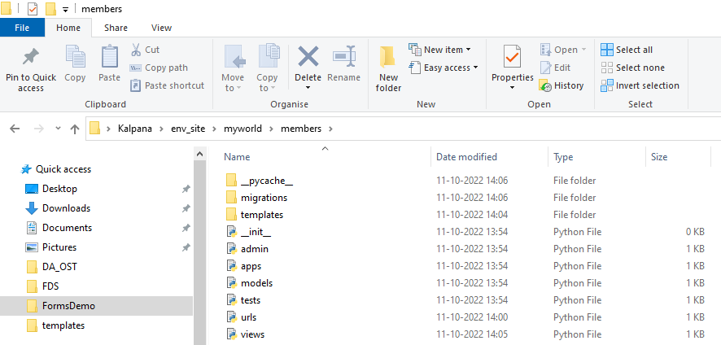
Templates
Create a templates folder inside the members folder, and create a HTML file named myfirst.html.

Slide 88
Templates
members/templates/myfirst.html:
<!DOCTYPE html>
<html>
<body> <h1>Hello World!</h1>
<p>Welcome to my first Django project!</p>
</body>
</html>

Slide 89
Templates
Modify the View
Open the views.py file and replace the index view with this:
members/views.py:
from django.http import HttpResponse
from django.template import loader
def index(request):
template = loader.get_template('myfirst.html')
return HttpResponse(template.render())

Slide 90
Templates
Change Settings
To be able to work with more complicated stuff than "Hello World!", We have to tell Django that a new app is created.
This is done in the settings.py file in the myworld folder.
Look up the INSTALLED_APPS[] list and add the members app like this:
myworld/settings.py:
INSTALLED_APPS = [
'django.contrib.admin',
'django.contrib.auth',
'django.contrib.contenttypes',
'django.contrib.sessions',
'django.contrib.messages',
'django.contrib.staticfiles',
'members.apps.MembersConfig' ]

Slide 91
Templates
Then run this command:
py manage.py migrate
Start the server by navigating to the /myworld folder and execute this command:
python manage.py runserver
In the browser window, type 127.0.0.1:8000/members/ in the address bar.

Slide 92
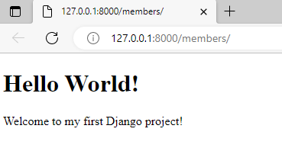
Templates

Slide 93
Loading Templates
#Open views.py under members folder and you will see the following:
from django.http import HttpResponse
import datetime
def today_is(request):
now = datetime.datetime.now()
t = template.Template("<html><body>Time is{{now}}</body></html>")
c = template.Context({'now': now})
html = t.render(c)
return HttpResponse(html)

Slide 94
Loading Templates
def today_is(request):
now = datetime.datetime.now()
t = template.Template("<html><body>Time is{{now}}</body></html>")
c = template.Context({'now': now})
html = t.render(c)
return HttpResponse(html)

Slide 95
Loading Templates
Start the server and you will get the current date and time
Create a new file called datetime.html inside newapp/templates/newapp directory and add the following code to it

Slide 96
Loading Templates
<!DOCTYPE html>
<html lang="en">
<head> <meta charset="UTF-8"> <title>Current Time</title> </head>
<body>
{# This is a comment #}
{# check the existence of now variable in the template using if tag #}
{% if now %}
<p>Time is {{ now }}</p>
{% else %}
<p>now variable is not available</p>
{% endif %}
</body>
</html>

Slide 97
Loading Templates
#Open views.py under members folder and you will see the following:
from django.http import HttpResponse
import datetime
def today_is(request):
now = datetime.datetime.now()
t = template.loader.get_template(‘newapp/datetime.html')
c = template.Context({'now': now})
html = t.render(c)
return HttpResponse(html)

Slide 98
Loading Templates

Slide 99
Rendering Templates
Most of the time a view does the following task:
Pull data from the database using models
Load the template file and create Template object.
Create Context object to supply data to the template.
Call render() method.
Create HttpResponse() and send it to the client.
Django provides a function called render_to_response() to do all things mentioned above from step 2 to 5. It accepts two arguments template name and a dictionary (which will be used to create Context object).
To use render_to_response() you must first import it from django.shortcuts module.

Slide 100
Rendering Templates
def today_is(request):
now = datetime.datetime.now()
return render_to_response(‘newapp/datetime.html', {'now': now })

Slide 101
Rendering Templates
The render() function works similar to render_to_response() but it provides some additional variables inside the Django templates (although there are many other subtle differences between render() and render_to_response() but for now we will not going to discuss them).
One such variable is request which is an object of type HttpRequest.
Recall that every view function accepts request object as a first parameter. If you want to access request object inside templates you must use render() instead of render_to_response().
At this point, we can't do anything useful with request object but just to give you an example, we will try to get the scheme used to access the web page.
Open datetime.html template and make the following changes:

Slide 102
Rendering Templates
<!DOCTYPE html>
<html lang="en">
<head> <meta charset="UTF-8"> <title>Current Time</title> </head>
<body>
{# This is a comment #}
{# check the existence of now variable in the template using if tag #}
{% if now %}
<p>Current date and time is {{ now }}</p>
{% else %}
<p>now variable is not available</p>
{% endif %}
<p>Current scheme: {{ request.scheme }}</p>
</body> </html>

Slide 103
Rendering Templates
The request object has an attribute called scheme which returns the scheme of the request.
In other words, if the page is requested using the http then scheme is http.
On the other hand, if it is requested using https then scheme is https.

Slide 104
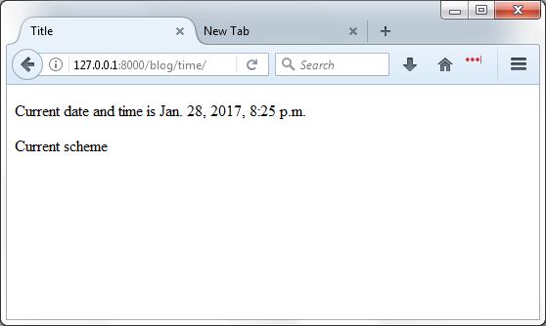
Rendering Templates

Slide 105
Rendering Templates
Notice that nothing is printed in the place of request.scheme because we are using render_to_response().
To use render() function first import it from django.shortcuts module.
Let's update today_is() view function to use render() instead of render_to_response() function.
from django.http import HttpResponse
import datetime from django.shortcuts
import render #...
def today_is(request):
now = datetime.datetime.now()
return render(request, ‘newapp/datetime.html', {'now': now})

Slide 106
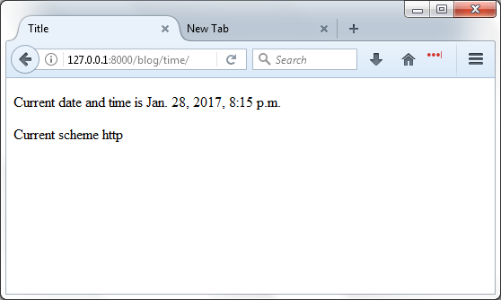
Rendering Templates

Slide 107
Create Forms
Django forms are an advanced set of HTML forms that can be created using python and support all features of HTML forms in a pythonic way.
When one creates a Form class, the most important part is defining the fields of the form.
Each field has custom validation logic, along with a few other hooks.

Slide 108
Create Forms
Forms are basically used for taking input from the user in some manner and using that information for logical operations on databases. For example, Registering a user by taking input as his name, email, password, etc.
Django maps the fields defined in Django forms into HTML input fields.
Django handles three distinct parts of the work involved in forms:
preparing and restructuring data to make it ready for rendering
creating HTML forms for the data
receiving and processing submitted forms and data from the client

Slide 109
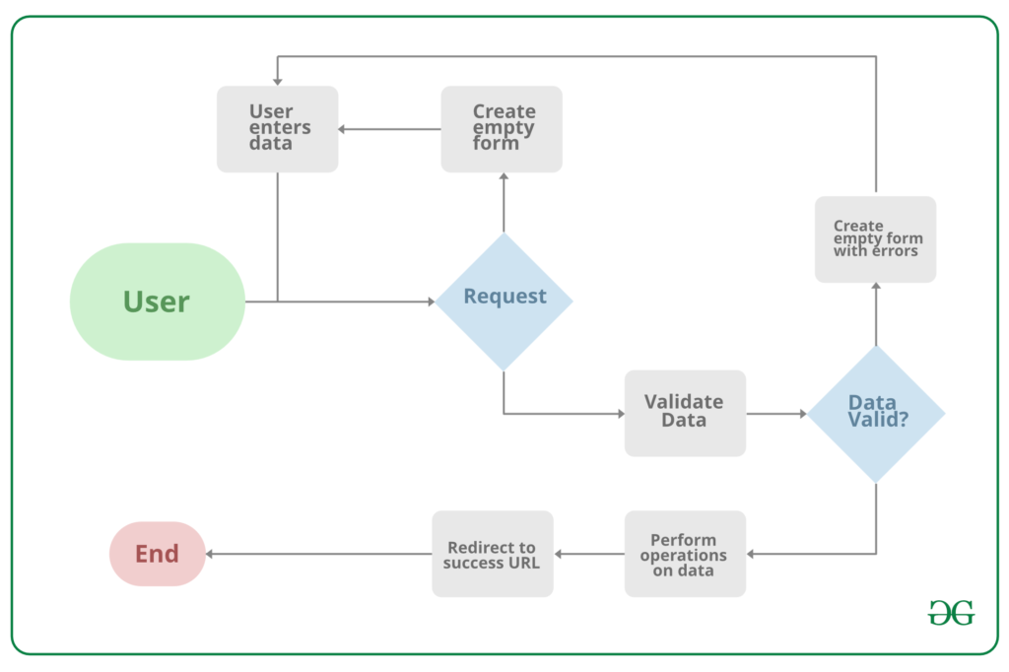
Create Forms

Slide 110
Create Forms
Django forms are an advanced set of HTML forms that can be created using python and support all features of HTML forms in a pythonic way.
from django import forms
# creating a form
class InputForm(forms.Form):
first_name = forms.CharField(max_length = 200)
last_name = forms.CharField(max_length = 200)
roll_number = forms.IntegerField(
help_text = "Enter 6 digit roll number")
password = forms.CharField(widget = forms.PasswordInput())

Slide 111
Forms
views.py
from django.shortcuts import render
from .forms import InputForm
# Create your views here.
def home_view(request):
context ={}
context['form']= InputForm()
return render(request, "home.html", context)

Slide 112
Forms
Syntax :
Field_name = forms.FieldType(attributes)
views.py
from django.shortcuts import render
from .forms import InputForm
# Create your views here.
def home_view(request):
context ={}
context['form']= InputForm()
return render(request, "home.html", context)

Slide 113
Forms
templates > home.html
<form action = "" method = "post">
{% csrf_token %}
{{form }}
<input type="submit" value=Submit">
</form>
All set to check if the form is working or not let’s visit http://localhost:8000/

Slide 114
Forms
<form action = "" method = "post">
{% csrf_token %}
{{form.as_p }}
<input type="submit" value=Submit">
</form>

Slide 115
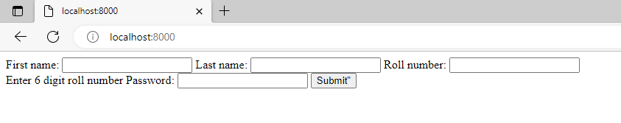
Forms

Slide 116
Form Validation
models.py – (Project folder)
from django.db import models
class User(models.Model):
# username field
username = models.CharField(max_length=30, blank=False, null=False)
# password field
password = models.CharField(max_length=8, blank=False, null=False)

Slide 117
Form Validation
Now, we have to migrate the models. To make migrations, run the following command.
python manage.py makemigrations
python manage.py migrate

Slide 118
Form validation
#forms.py
from django.forms import ModelForm
from django import forms
from validation.models import User
class UserForm(ModelForm):
# meta data for displaying a form
class Meta:
# model
model = User
# displaying fields
fields = '__all__'
# method for cleaning the data
def clean(self):
super(UserForm, self).clean()
# getting username and password from cleaned_data
username = self.cleaned_data.get('username')
password = self.cleaned_data.get('password')
# validating the username and password
if len(username) < 5:
self._errors['username'] = self.error_class(['A minimum of 5 characters is required'])
if len(password) < 8:
self._errors['password'] = self.error_class(['Password length should not be < 8 characters'])
return self.cleaned_data

Slide 119
Form Validation
Create a templates folder and a template called home.html inside the app. And paste the following code inside the home template.
{% load crispy_forms_tags %}
<!DOCTYPE html> <html lang="en">
<head> <meta charset="UTF-8" />
<meta name="viewport" content="width=device-width, initial-scale=1.0" /> <title>Form Validation</title> <link rel="stylesheet" href="https://maxcdn.bootstrapcdn.com/bootstrap/4.0.0/css/bootstrap.min.css" integrity="sha384-Gn5384xqQ1aoWXA+058RXPxPg6fy4IWvTNh0E263XmFcJlSAwiGgFAW/dAiS6JXm" crossorigin="anonymous" /> </head>

Slide 120
Form Validation
<body>
<div class="container">
<div class="row">
<div class="col-md-4 col-md-offset-4">
<h2>User</h2>
<form action="" method="post"> {%csrf_token%}
{{ form|crispy }}
<div class="form-group">
<button type="submit" class="btn btn-success"> Add User </button> </div> </form>
</div>
</div>
</div>
</body> </html>

Slide 121
Form Validation
from django.shortcuts import render
from django.http import HttpResponse
from .forms import UserForm
# Create your views here.
def home_view(request):
# cheking the request
if request.method == 'POST':
# passing the form data to LoginForm
user_details = UserForm(request.POST)
# validating the user_details with is_valid() method
if user_details.is_valid():
# writing data to the database
user_details.save()

Slide 122
Form Validation
# redirect to another page with success message
return HttpResponse("Data submitted successfully")
else:
# redirect back to the user page with errors
return render(request, 'validation/home.html', {'form':user_details})
else:
# in case of GET request
form = UserForm(None)
return render(request, 'validation/home.html', {'form':form})

Slide 123
Form Validation
from django.contrib import admin
from django.urls import path
from validation.views import home_view
urlpatterns = [
path('admin/', admin.site.urls),
path('', home_view, name='home'),
]

Slide 124
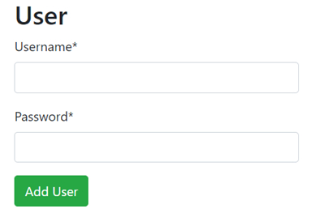
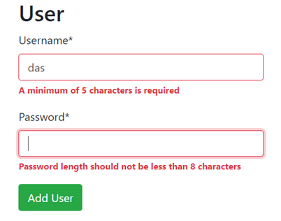
Form Validation

